Slide 1
Quick Sort

Slide 2
Quick Sort
Quicksort works efficiently as well as faster even for larger arrays or lists.
As a pivot value, we can choose either first, last or the middle value or any random value. The general idea is that ultimately the pivot value is placed at its proper position in the array by moving the other elements in the array to the left or right.

Slide 3
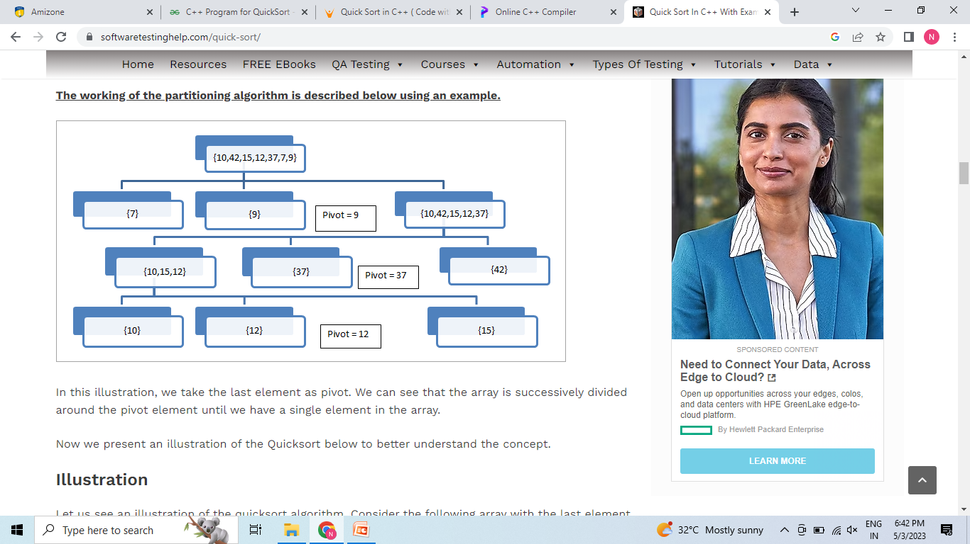

Slide 4
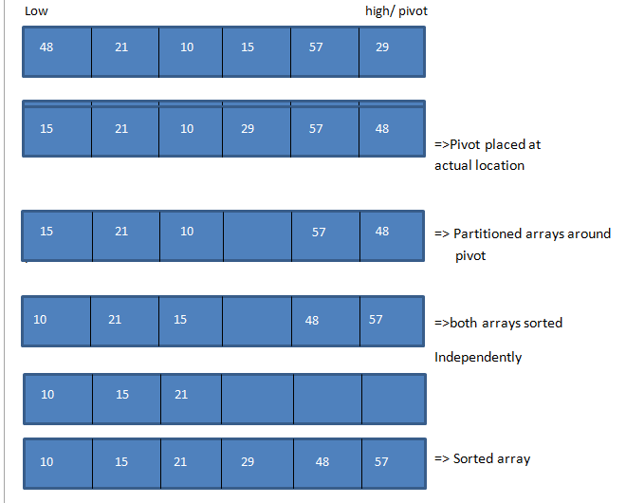

Slide 5
General Algorithm
quicksort(A, low, high)
begin
Declare array A[N] to be sorted
low = 1st element; high = last element; pivot
if(low < high)
begin
pivot = partition (A,low,high);
quicksort(A,low,pivot-1)
quicksort(A,pivot+1,high)
End
end

Slide 6
Merge Sort
Merge sort algorithm uses the “divide and conquer” strategy wherein we divide the problem into subproblems and solve those subproblems individually.
These subproblems are then combined or merged together to form a unified solution.

Slide 7
Merge Sort
Merge sort is performed using the following steps:
#1) The list to be sorted is divided into two arrays of equal length by dividing the list on the middle element. If the number of elements in the list is either 0 or 1, then the list is considered sorted.
#2) Each sublist is sorted individually by using merge sort recursively.
#3) The sorted sublists are then combined or merged together to form a complete sorted list.

Slide 8
Merge Sort
Declare an array Arr of length N If N=1, Arr is already sorted If N>1, Left = 0, right = N-1 Find middle = (left + right)/2 Call merge_sort(Arr,left,middle) =>sort first half recursively Call merge_sort(Arr,middle+1,right) => sort second half recursively Call merge(Arr, left, middle, right) to merge sorted arrays in above steps. Exit

Slide 9
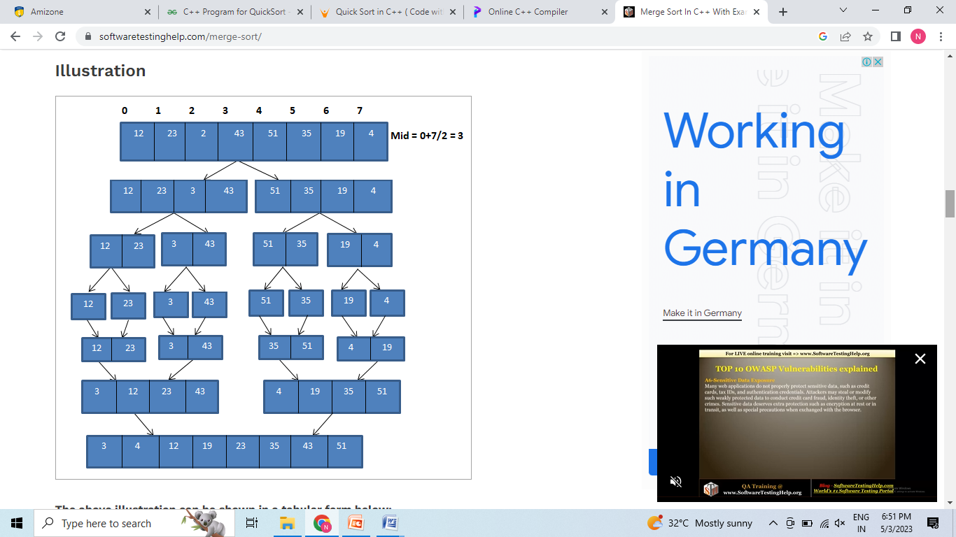

Slide 10
Bubble Sort
Bubble Sort is the simplest sorting algorithm that works by repeatedly swapping the adjacent elements if they are in the wrong order. This algorithm is not suitable for large data sets.
In Bubble Sort algorithm,
traverse from left and compare adjacent elements and the higher one is placed at right side.
In this way, the largest element is moved to the rightmost end at first.
This process is then continued to find the second largest and place it and so on until the data is sorted

Slide 11
Bubble Sort
Input: arr[] = {6, 0, 3, 5}

Slide 12
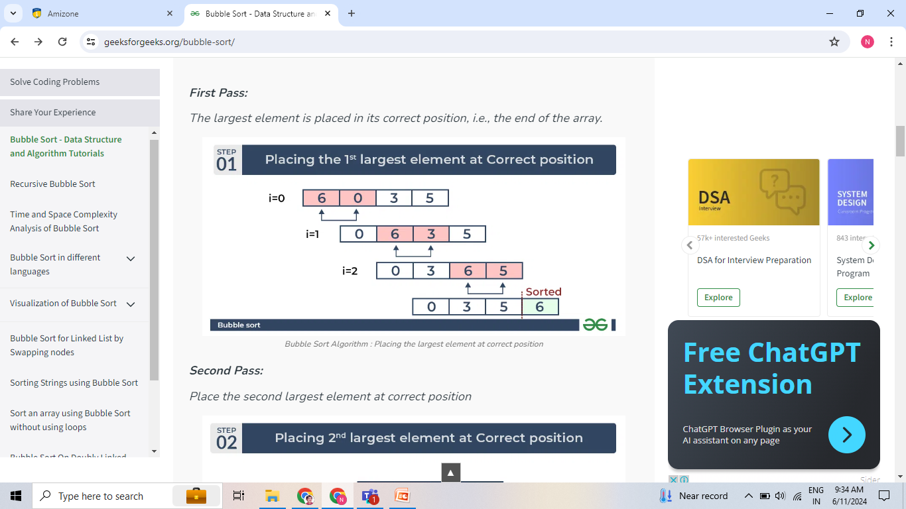
Bubble Sort

Slide 13
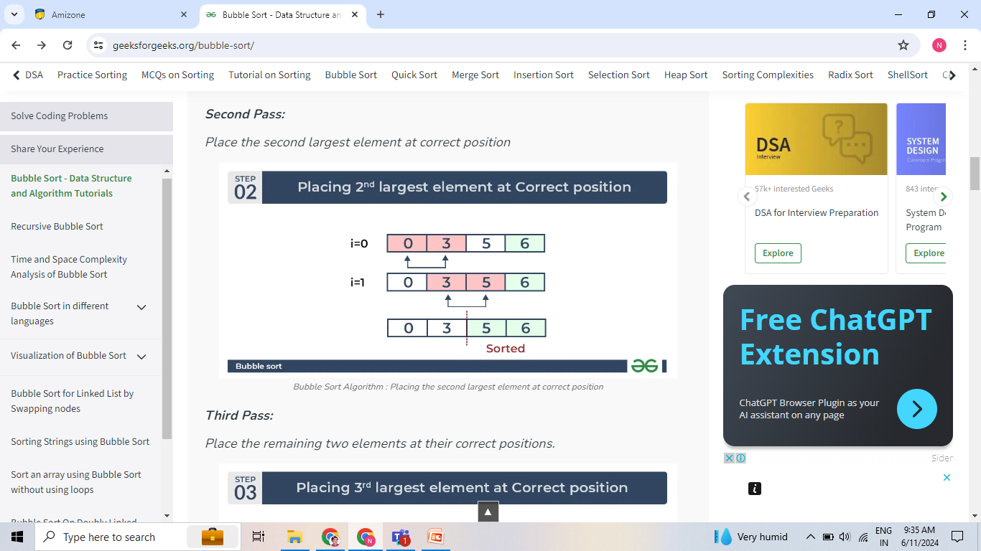
Bubble Sort

Slide 14
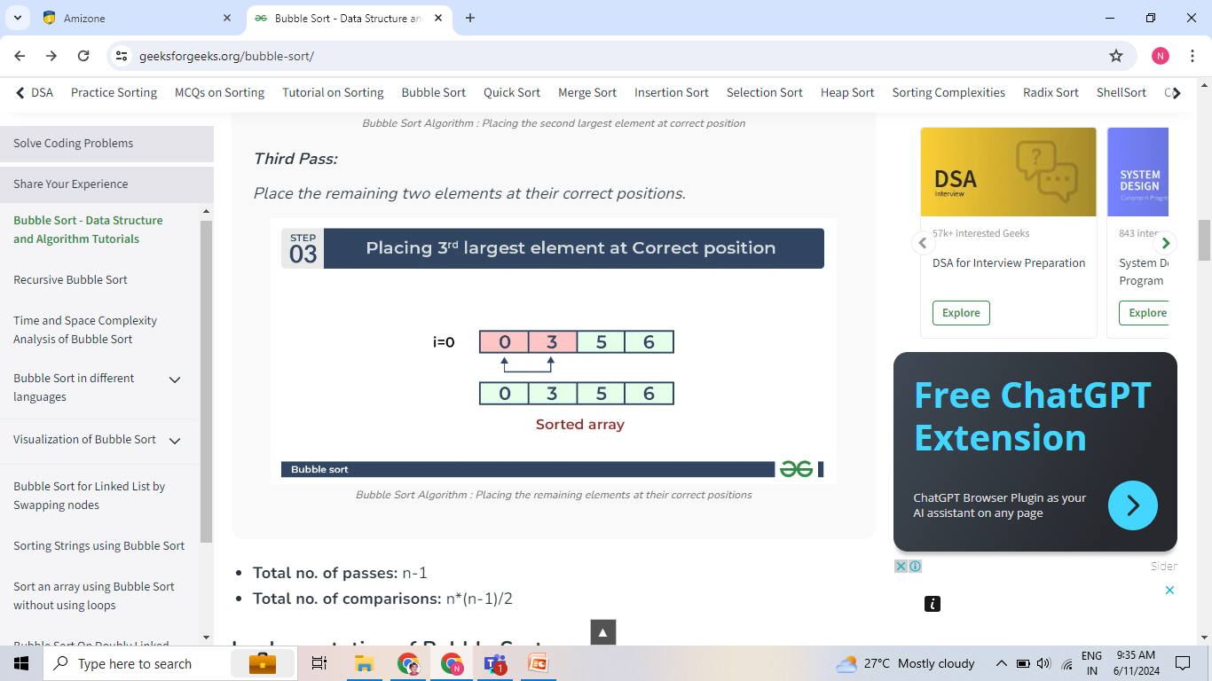
Bubble Sort

Slide 15
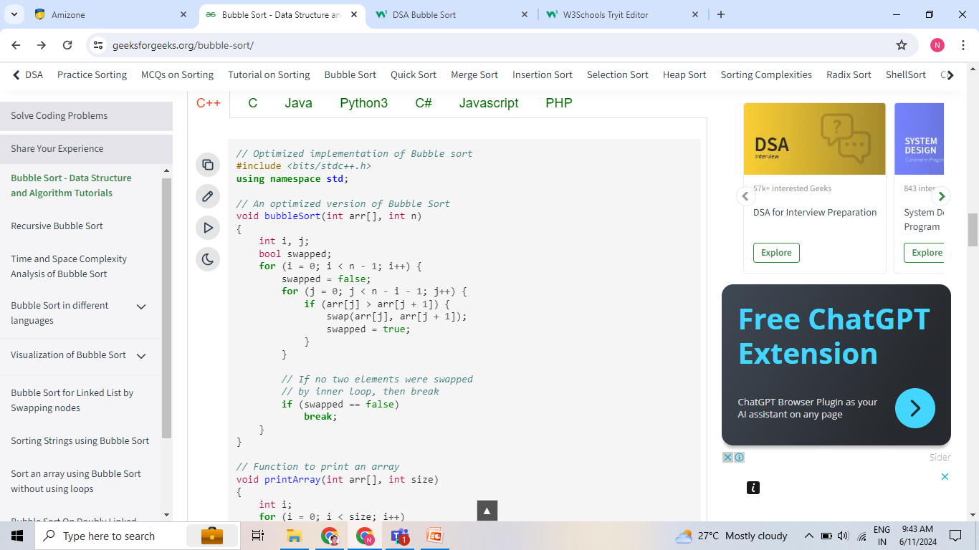
Bubble Sort

